Slide 1
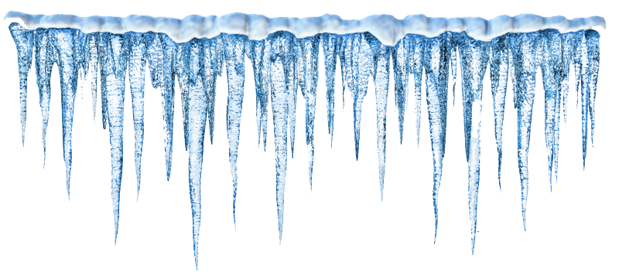
Science Saturday
Icicles
This Photo by Unknown Author is licensed under CC BY-NC

Slide 2
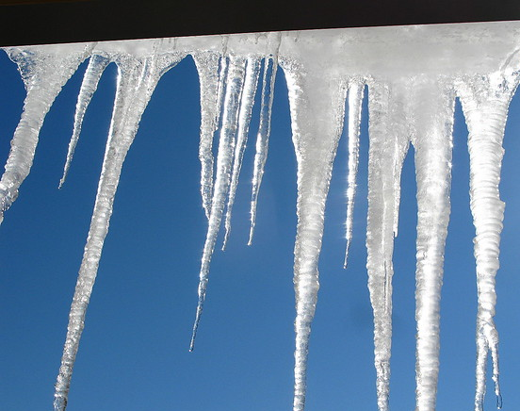
How do Icicle's form?
Icicles can form during bright, sunny, but subfreezing weather, when ice or snow melted by sunlight or some other heat source (such as a poorly insulated building), refreezes as it drips off under exposed conditions. Over time continued water runoff will cause the icicle to grow.
This Photo by Unknown Author is licensed under CC BY

Slide 3

Research questions:
Why are icicles shaped like carrots?
  Answer: Gravity pulls the melted snow down while the temperature gets very cold, and the water freezes before it fully melts. The result is a pointed shape of ice.
What do they have in common or what is needed to make an icicle?
  Answers: H20, sun, air, water, cold, & snow.
This Photo by Unknown Author is licensed under CC BY-NC-ND

Slide 4
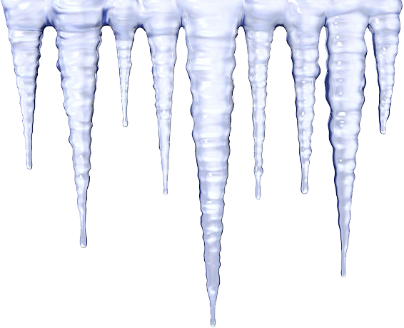
Let’s make icicles!
Materials:
  Icicle craft paper
  Photos for reference
  Markers
  Tape
  Scissors
  Hole puncher
  Glue
  String
  Glitter
  Fuzzy decorations
This Photo by Unknown Author is licensed under CC BY-NC

Slide 5
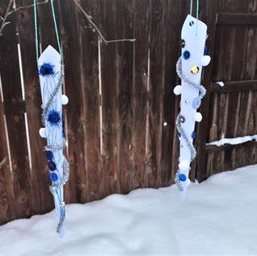
Steps
Color icicles
Cut out icicles
Fold pattern together
Tape them closed
Add glue & glitter and any other decorations for extra sparkle!

